Slide 1

Project Overview
Introducing the CRM System Implementation project, aimed at enhancing customer interactions, data management, and overall satisfaction. Presented by Aya Chkioua.
by aya chkioua

Slide 2
Introduction to the Project
1
Project Background
The project involves the implementation of a Customer Relationship Management (CRM) system to streamline customer interactions, improve data management, and enhance customer satisfaction.

Slide 3

Importance of the Project
1
Key Significance
Streamlining customer interactions will lead to improved customer relationships and enhanced data management for better decision-making and personalized customer experiences.

Slide 4
Key Stakeholders
Sales and Marketing Teams
Customer Support
IT Department
Invested in using the CRM to provide efficient service and support to customers.
Responsible for the technical integration and maintenance of the CRM system.
Engaged in leveraging the CRM for customer data and lead management.
Customers
Executive Leadership
Directly engage with the system for service, orders, and feedback.
Provide strategic direction and support for the CRM project.

Slide 5
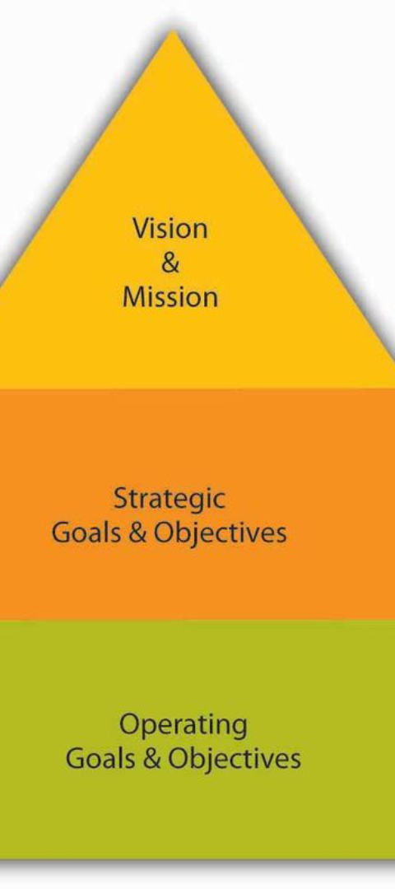
Project Objectives
1
Overall Objective
Implement a CRM system to centralize customer data, streamline processes, and improve customer engagement. Align with the company's strategic goal of increasing customer satisfaction and loyalty.

Slide 6

Specific Goals
1
Detailed Goals
1. Implement CRM software within the next six months. 2. Train employees on CRM usage. 3. Achieve a 20% improvement in customer response time.

Slide 7

Goal 1 - CRM Implementation
1
Objective Details
Introduce the CRM system, its features, and benefits. Highlight the importance of a unified customer database.

Slide 8
Goal 2 - Employee Training
1
Objective Details
Develop and execute a comprehensive training program to ensure all relevant employees are proficient in using the CRM.

Slide 9
Goal 3 - Improved Customer Response Time
1
Objective Details
Implement processes to reduce customer response time and utilize CRM analytics for more efficient customer support.

Slide 10
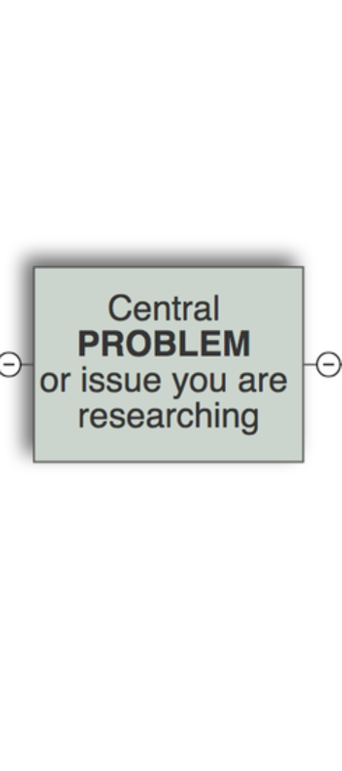
Scope and Limitations
1
Project Scope
Inclusions: CRM software acquisition, customization, and employee training. Exclusions: Major modifications to existing IT infrastructure.

